Slide 1




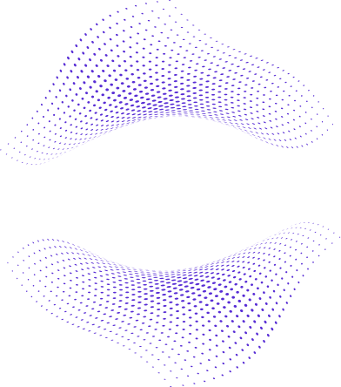
DSA
DATA STRUCTURES & ALGORITHMS

Slide 2

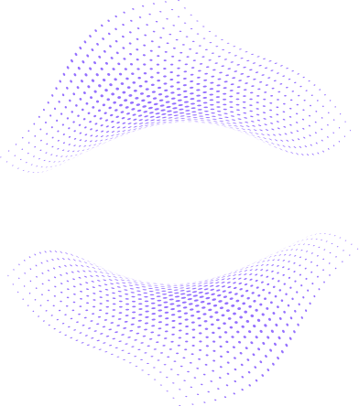


CONTENTS
I
II
III
DSA & ADT
SORTING ALGORITHMS
SHORTEST PATH ALGORITHMS

Slide 3


I. DSA & ADT
Data Structures and Algorithms (DSA) are essential for efficient problem-solving in computing, while Abstract Data Types (ADTs) define the high-level behavior of data structures, enabling organized and optimized solutions.
01
WHAT IS DSA?
DSA stands for Data Structures and Algorithms, which are foundational concepts in computer science and software engineering. Here’s a breakdown:
Data Structures: These are ways of organizing and storing data in a computer so it can be accessed and modified efficiently. Common data structures include arrays, linked lists, stacks, queues, trees, graphs, and hash tables. Each structure is optimized for certain operations and helps in solving different types of computational problems.
Algorithms: These are step-by-step instructions or rules for performing a task or solving a problem. Algorithms work with data structures to perform specific operations like sorting, searching, traversing, or optimizing. Some examples include sorting algorithms (like QuickSort, MergeSort), searching algorithms (like Binary Search), and algorithms for pathfinding (like Dijkstra’s).

Slide 4
I. DSA & ADT
Data Structures and Algorithms (DSA) are essential for efficient problem-solving in computing, while Abstract Data Types (ADTs) define the high-level behavior of data structures, enabling organized and optimized solutions.
02
WHAT IS ADT?
An Abstract Data Type (ADT) is a model for a data structure that defines the data type purely in terms of its behavior from the user's perspective, without specifying how it’s implemented. An ADT focuses on what operations are allowed on the data and what their behavior should be. For example:
A Stack ADT allows operations like push (add an item), pop (remove the top item), and peek (view the top item without removing it).
A Queue ADT allows operations like enqueue (add an item at the end) and dequeue (remove the item at the front).

Slide 5

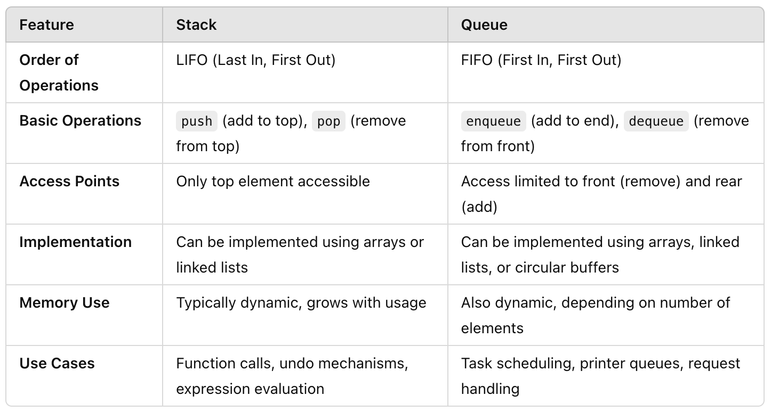
I. DSA & ADT
03
DIFFERENCES BETWEEN QUEUE AND STACK DATA STRUCTURE.

Slide 6
I. DSA & ADT
04
COMMON WAYS TO IMPLEMENT STACK AND QUEUE
Stack Implementations:
Array-based Implementation: A static array is used where a pointer keeps track of the top element.
Linked List-based Implementation: A singly or doubly linked list can be used, where the top of the stack is represented by the head or the last node.
Dynamic Array-based Implementation (Resizable Stack): A dynamic array that automatically resizes as elements are added or removed.
Queue Implementations:
Array-based Implementation: A static array is used with two pointers: one for the front of the queue and one for the rear.
Circular Array-based Implementation: Similar to the array-based implementation, but it reuses the space vacated by dequeued elements by wrapping around the array.
Linked List-based Implementation: A singly or doubly linked list can be used, where the front of the queue is represented by the head node, and the rear by the tail node.

Slide 7



II. SORTING ALGORITHMS
Sorting algorithms are fundamental tools in computer science used to arrange data in a specific order, typically ascending or descending. Sorting helps in organizing data, making it easier to search, analyze, and manage.
Commonly, sorting is applied to lists, arrays, and records, and it plays a critical role in improving the efficiency of other algorithms (like search algorithms) by structuring data in a predictable manner.Here are two commonly used sorting algorithms that will be introduced:
01
02
BUBBLE SORT
MERGE SORT

Slide 8
II. SORTING ALGORITHMS
01
BUBBLE SORT
Bubble Sort is one of the simplest sorting algorithms. It works by repeatedly stepping through the list, comparing adjacent elements, and swapping them if they are in the wrong order.
This process is repeated until the entire list is sorted. The algorithm derives its name from the way larger elements "bubble" to the top of the list, while smaller elements settle at the bottom after each pass.

Slide 9
II. SORTING ALGORITHMS
01
BUBBLE SORT
How Bubble Sort Works:
Starting from the first element, the algorithm compares each pair of adjacent elements.
If the current element is greater than the next element, they are swapped.
The algorithm continues comparing each pair of adjacent elements until it reaches the end of the list.
This process repeats from the beginning until no more swaps are needed, meaning the list is sorted.

Slide 10
II. SORTING ALGORITHMS
01
BUBBLE SORT
LET'S SORT THE LIST: [5, 3, 8, 4, 2].
Pass 1:
Compare 5 and 3: 5 > 3, so we swap → [3, 5, 8, 4, 2]
Compare 5 and 8: 5 < 8, no swap.
Compare 8 and 4: 8 > 4, so we swap → [3, 5, 4, 8, 2]
Compare 8 and 2: 8 > 2, so we swap → [3, 5, 4, 2, 8]
End of Pass 1. Largest element (8) has bubbled to the end.

Slide 11
II. SORTING ALGORITHMS
01
BUBBLE SORT
Pass 2:
Compare 3 and 5: 3 < 5, no swap.
Compare 5 and 4: 5 > 4, so we swap → [3, 4, 5, 2, 8]
Compare 5 and 2: 5 > 2, so we swap → [3, 4, 2, 5, 8]
End of Pass 2. Next largest element (5) is now in the correct position.

Slide 12
II. SORTING ALGORITHMS
01
BUBBLE SORT
Pass 3:
Compare 3 and 4: 3 < 4, no swap.
Compare 4 and 2: 4 > 2, so we swap → [3, 2, 4, 5, 8]
End of Pass 3. Next largest element (4) is sorted.
Pass 4:
Compare 3 and 2: 3 > 2, so we swap → [2, 3, 4, 5, 8]
End of Pass 4. The list is fully sorted, and no more passes are needed.

Slide 13
II. SORTING ALGORITHMS
02
MERGE SORT
Merge sort is a divide-and-conquer sorting algorithm that works by dividing the list into smaller sublists, sorting those sublists, and then merging them back together to form a sorted list.
It is particularly useful for sorting large datasets, which is significantly faster than simpler algorithms like Bubble Sort for large lists. Unlike Bubble Sort, Merge Sort does not rely on in-place swaps; instead, it divides the list into smaller sections, sorts them individually, and then merges the sorted sections back together.

Slide 14
II. SORTING ALGORITHMS
02
MERGE SORT
How Merge Sort Works
Divide: Continuously divide the list in half until each sublist contains only one element. A single element is inherently sorted, so once the list is fully split, you have the smallest possible sublists.
Conquer (Sort and Merge): Start merging sublists in pairs, creating sorted sublists. During the merging process, elements from two sublists are compared, and the smaller element is placed into the new list first.
Combine: Continue merging the sorted sublists until you get one final sorted list.

Slide 15
II. SORTING ALGORITHMS
02
MERGE SORT
LET'S SORT THE LIST: [38, 27, 43, 3, 9, 82, 10].
Split the array into halves until we get single-element arrays:
[38, 27, 43, 3, 9, 82, 10] ➔ [38, 27, 43] and [3, 9, 82, 10]
[38, 27, 43] ➔ [38] and [27, 43]
[27, 43] ➔ [27] and [43]
[3, 9, 82, 10] ➔ [3, 9] and [82, 10]
[82, 10] ➔ [82] and [10]

Slide 16
II. SORTING ALGORITHMS
02
MERGE SORT
Sort and merge the subarrays:
[27] and [43] merge to form [27, 43]
[38] and [27, 43] merge to form [27, 38, 43]
[3] and [9] merge to form [3, 9]
[82] and [10] merge to form [10, 82]
[3, 9] and [10, 82] merge to form [3, 9, 10, 82]
Finally, [27, 38, 43] and [3, 9, 10, 82] merge to form the sorted array [3, 9, 10, 27, 38, 43, 82]

Slide 17
III. SHORTEST PATH ALGORITHMS
Shortest path algorithms are methods for finding the shortest path from a starting node (or point) to an ending node in a graph, where each connection (or edge) between nodes has a certain weight or cost associated with it.
These algorithms are widely used in network routing, transportation planning, and other areas where determining optimal paths is essential. Here are two commonly used shortest path algorithms that will be introduced:
01
02
DIJKSTRA’S ALGORITHMS
PRIM-JARNIK ALGORITHMS

Slide 18
III. SHORTEST PATH ALGORITHMS
01
DIJKSTRA'S ALGORITHMS
Dijkstra's Algorithm is a popular algorithm for finding the shortest path from a single source node to all other nodes in a graph with non-negative edge weights. It is widely used in network routing, navigation systems, and many other applications where efficient pathfinding is required.
The algorithm was developed by Dutch computer scientist Edsger W. Dijkstra in 1956.

Slide 19
III. SHORTEST PATH ALGORITHMS
01
DIJKSTRA'S ALGORITHMS
How Dijkstra's Algorithm Works:
Step 1 - Initialization: Set the distance to the source node as 0 (since the distance from the source to itself is zero) and all other nodes as infinity. Use a priority queue to keep track of the nodes with the smallest known distance.
Step 2 - Exploration and Relaxation: Extract the node with the smallest distance from the queue.
For each neighboring node of the current node, calculate the potential new distance (current distance + edge weight). If the calculated distance is less than the current stored distance for that neighbor, update the neighbor’s distance and push it into the priority queue with this updated distance.

Slide 20
III. SHORTEST PATH ALGORITHMS
01
DIJKSTRA'S ALGORITHMS
How Dijkstra's Algorithm Works:
Step 3 - Repetition: Repeat the process until all nodes are processed or the queue is empty. At the end, the distance array will contain the shortest distance from the source to each node in the graph.
Path Reconstruction (Optional): If you want to reconstruct the actual path, maintain a “predecessor” array that records the previous node for each node in the shortest path found.

Slide 21
III. SHORTEST PATH ALGORITHMS
01
DIJKSTRA'S ALGORITHMS
Characteristics of Dijkstra’s Algorithm:
Time Complexity: O((V + E) log V) with a priority queue, where V is the number of vertices and E is the number of edges.
Space Complexity: O(V), due to storage for distances and the priority queue.
Limitations: Cannot handle negative edge weights, as the algorithm assumes that once a node is processed with the smallest known distance, its shortest path is final.
Greedy Approach: Dijkstra’s algorithm is a greedy algorithm, as it always selects the shortest known path at each step.

Slide 22
III. SHORTEST PATH ALGORITHMS
01
DIJKSTRA'S ALGORITHMS
Consider a graph with the following nodes and edges, where edge weights represent distances:
Nodes: A, B, C, D, E
Edges with weights: (A, B, 4), (A, C, 1), (B, C, 2), (B, D, 5), (C, D, 8), (C, E, 10), (D, E, 2)

Slide 23
III. SHORTEST PATH ALGORITHMS
01
DIJKSTRA'S ALGORITHMS
To find the shortest path from A to all other nodes:
Start at A, with distances: A = 0, B = ∞, C = ∞, D = ∞, E = ∞.
Update distances for neighbors of A: B = 4, C = 1. Set A as visited.
Select C (smallest distance = 1). Update distances for neighbors: D = 9, E = 11. Set C as visited.
Select B (distance = 4). Update D = 9 (from B). Set B as visited.
Select D (distance = 9). Update E = 11. Set D as visited.
Final distances: A = 0, B = 4, C = 1, D = 9, E = 11.

Slide 24
III. SHORTEST PATH ALGORITHMS
02
PRIM-JARNIK ALGORITHMS
Prim-Jarnik Algorithm (often referred to simply as Prim's Algorithm) is a greedy algorithm used to find the Minimum Spanning Tree (MST) of a weighted, connected, undirected graph. The MST connects all nodes in a graph with the minimum possible total edge weight, ensuring there are no cycles.
This is particularly useful in network design (like connecting multiple network hubs at minimum cost) and other applications where we want to link points efficiently.

Slide 25
III. SHORTEST PATH ALGORITHMS
02
PRIM-JARNIK ALGORITHMS
How Prim's Algorithm Works:
Prim’s algorithm starts with an arbitrary node and grows the MST one edge at a time by selecting the smallest-weight edge that connects a node in the MST to a node outside of it. The algorithm continues until all nodes are included in the MST.
Step 1 - Initialization:
Start by selecting an arbitrary node as the initial node of the MST.
Maintain a set of nodes that are part of the MST and another set of nodes yet to be connected.

Slide 26
III. SHORTEST PATH ALGORITHMS
02
PRIM-JARNIK ALGORITHMS
Step 2 - Growing the MST: Identify the smallest-weight edge that connects a node in the MST to a node outside the MST. Add this edge and the new node to the MST. Repeat this process, expanding the MST by one edge at a time, always choosing the smallest possible connecting edge.
Step 3 - Termination: The algorithm terminates when all nodes are part of the MST.

Slide 27
III. SHORTEST PATH ALGORITHMS
02
PRIM-JARNIK ALGORITHMS
Characteristics of Prim’s Algorithm:
Time Complexity:
O(V²) for a simple adjacency matrix and linear scan.
O(E log V) with an optimized priority queue, where V is the number of vertices and E is the number of edges.
Space Complexity: O(V + E) for storing the graph, distance values, and priority queue.
Greedy Approach: Prim's Algorithm is greedy because it always picks the smallest available edge that expands the MST without forming a cycle.
Optimality: It produces an optimal solution for the MST in any connected, weighted, undirected graph.

Slide 28
III. SHORTEST PATH ALGORITHMS
02
PRIM-JARNIK ALGORITHMS
Consider a graph with nodes A, B, C, D, and E, and weighted edges as follows:
(A, B) with weight 2
(A, C) with weight 3
(B, C) with weight 1
(B, D) with weight 5
(C, D) with weight 4
(C, E) with weight 6
(D, E) with weight 7

Slide 29
III. SHORTEST PATH ALGORITHMS
02
PRIM-JARNIK ALGORITHMS
Starting from node A:
Add node A to the MST.
The smallest edge from A is (A, B) with weight 2. Add B to the MST.
Now, choose the smallest edge connected to either A or B. Edge (B, C) with weight 1 is smallest, so add C.
Next, choose the smallest edge from nodes A, B, or C to an outside node, which is (C, D) with weight 4.
Finally, the smallest connecting edge to the last unconnected node (E) is (C, E) with weight 6.
The MST includes nodes {A, B, C, D, E} and edges {(A, B), (B, C), (C, D), (C, E)} with a total weight of 13.

Slide 30
CONCLUSION AND KEY TAKEAWAYS
In summary, Data Structures and Algorithms (DSA) and Abstract Data Types (ADT) form the backbone of effective problem-solving in computer science and software development. DSA provides the tools and techniques to efficiently organize, manage, and process data, directly impacting the performance and scalability of applications. Meanwhile, ADTs serve as high-level templates that define data behavior without binding it to specific implementations, allowing flexibility and clear abstraction in code. Together, DSA and ADT enable developers to write efficient, adaptable, and maintainable code, providing a strong foundation for tackling complex computational tasks across various domains.

